Slide 1
OVERVIEW OF COVID-19 VACCINATION FOR PHC & COSEDA COUNTIES
NATIONAL COVID-19 VACCINATION CAMPAIGN
Current and Projected Vaccination Performance
Implementing Partner | PHC & COSEDA

Slide 2
OBJECTIVES
1. To discuss strategies for 100% coverage and beyond.
2. To build confidence and trust and facilitate delivery of planned results with available resources.

Slide 3
PRIME HEALTH CONSULTANTS NCVC R1 FEB 2023
S/N | County | Target 18years & above | Total Vaccinated in R1 | % in R1 | # of Teams for Round 1
1 | ABIEMNHOM | 5,657 | 10,147 | 179.4 | 16
2 | AWIEL CENTRE | 2,805 | 8,582 | 306.0 | 14
3 | FASHODA | 9,189 | 4,310 | 46.9 | 9
4 | GUIT | 3,114 | 8,332 | 267.6 | 13
5 | MANYO | 10,095 | 10,930 | 108.3 | 17
6 | NEGERO | 6,432 | 1,803 | 28.0 | 3
7 | POCHALLA | 15,768 | 17,477 | 110.8 | 27
8 | TONJ EAST | 29,253 | 30,676 | 104.9 | 52
9 | TONJ SOUTH | 26,119 | 19,629 | 75.2 | 47
PHC | COUNTIES | 108,432 | 111,886 | 103.2 | 198

Slide 4
PRIME HEALTH CONSULTANTS R2 March 2023
S/N | County | Target 18years & above | Total Vaccinated in R2 | % R2 | # of Teams for Round 2
1 | ABIEMNHOM | 10,790 | 11,941 | 110.7 | 19
2 | AWIEL CENTRE | 8785 | 15,586 | 177.4 | 16
3 | FASHODA | 5000 | 4,767 | 95.3 | 9
4 | GUIT | 10325 | 18,358 | 177.8 | 18
5 | MANYO | 9260 | 21,320 | 230.2 | 17
6 | NEGERO | 4897 | 5,507 | 112.5 | 9
7 | POCHALLA | 11,410 | 15,736 | 137.9 | 20
8 | TONJ EAST | 25,562 | 45,114 | 176.5 | 46
9 | TONJ SOUTH | 18,876 | 27,686 | 146.7 | 34
PHC | COUNTIES | 104,905 | 166,015 | 158.3 | 187

Slide 5
PRIME HEALTH CONSULTANTS R1 & R2

Slide 6
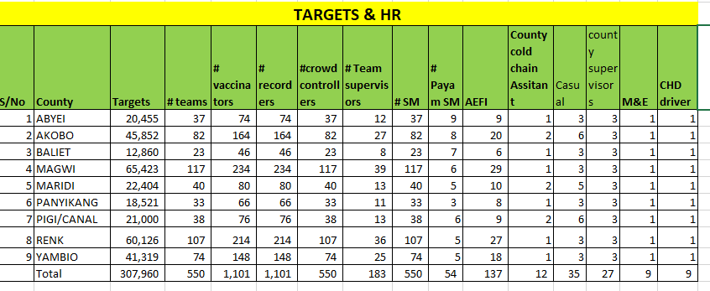

Slide 7
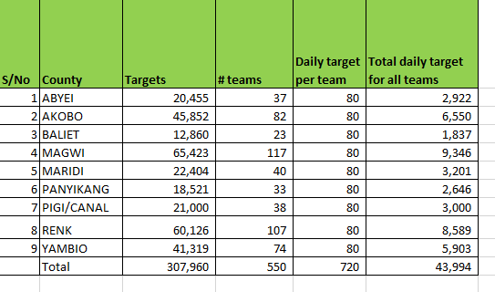
TEAMS DAILY TARGET

